Slide 1
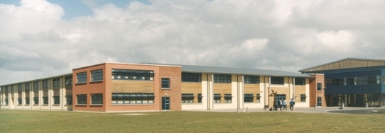
Parent/Guardian Information Session

Slide 2
Our Mission Statement
Every person is valued equally in accordance with our Christian Tradition at St. Caimin’s School.
Each person within the school community can enjoy developing to the fullest, while feeling cared for and safe.
Our educational structures are ordered, based on tolerance, fairness and respect, while sensitive to our changing world

Slide 3
 | Classrooms | Lockers | Corridors & Yard | Canteen | Toilets
Be Ready | Be on time Have your journal and equipment Be ready to learn | Use in the morning, at break time and lunchtime | Line up on one side outside the classroom | Line up at lunch queue Be patient and cooperative Follow all staff requests | Use in the morning, at break time and lunchtime or with permission slip from teacher
Be Respectful | One voice Hand up Listen, and support classmates Respect your space | Be patient and wait your turn | Use appropriate language Be mindful of your safety and that of others | Use ‘please’ and ‘thank you’ when it is due Clean the space you eat at | Be considerate of others needs Respect the space and keep it tidy for everyone
Be Responsible | Take ownership of your learning Be involved Know your goals and targets | Keep your locker area tidy Keep it locked and never share your code | Place your rubbish in the designated bin Give way where you can No mobile phones between classes | Place your rubbish in the designated bin | Wash your hands after use Report areas that need attention Toilets are not a social area to congregate

Slide 4
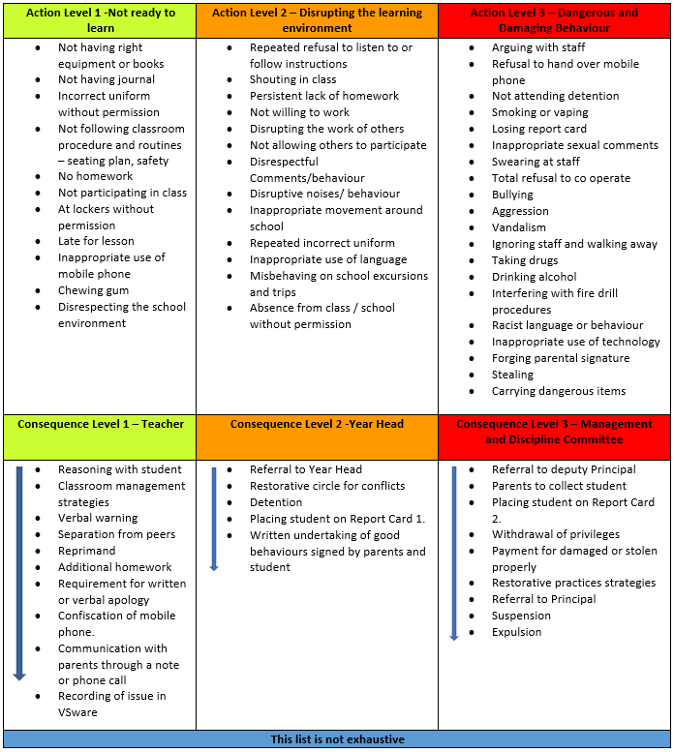
Check out school Journal 1st year = Page 19 2nd & 3rd year = Page 7 Senior = Page 7

Slide 5
Timekeeping
Regular school attendance and punctuality are essential factors in students learning

Slide 7
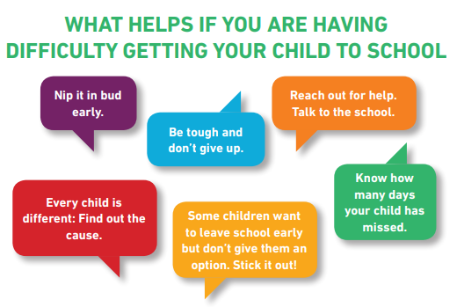
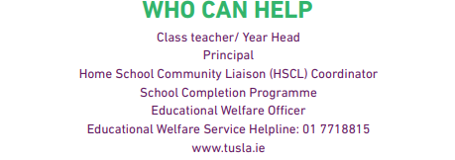

Slide 8
Attendance
Your attendance is so important and links with how well you do in your subjects
A student who is absent is required to keep up with school work
Absences need to be recorded on the VSware App
Students must attend school for duration of school day
Student must get permission from year head to leave the school grounds

Slide 9
Homework and Learning to Learn

Slide 10
Success Criteria
There is a genuine attempt made by the pupil to complete the homework to the best of his/her ability and to submit the work at a pre-agreed time.

Slide 11
Why do we do Homework?
Help us build on what we have learned in class
Practice skills
Ensure we understand new topics/concepts
Help prepare for next class
Help prepare for examinations

Slide 12
The Homework Journal
The place where all homework is recorded
Homework is recorded at the end of each class – there are many different types of homework
Parents and guardians should ensure that the student completes all homework to the best of his/her ability.
Parents should inform the teacher of any difficulties by means of a written note in the journal.

Slide 13
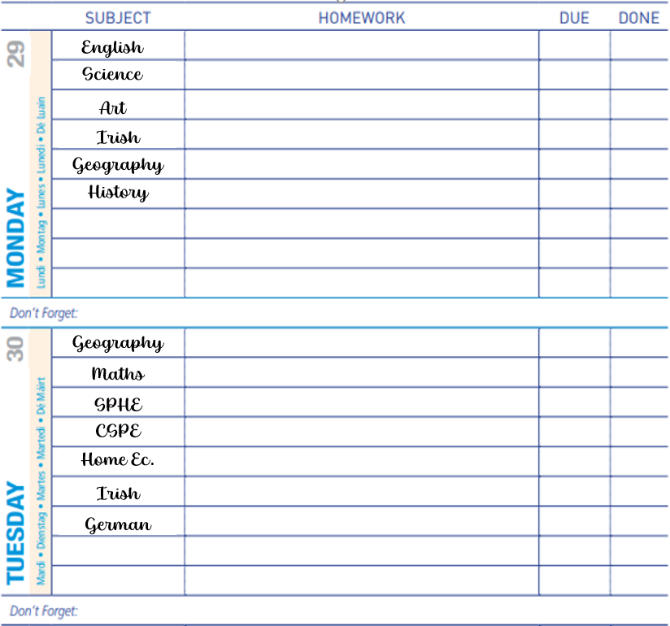

Slide 14
Homework can include the following types of activity:
Reading for pleasure
Reading for information and memorising
Preparation of presentations
Practice of exam techniques
Research/Project work
Revision
Visits to relevant museums, art galleries, theatre and other places of interest and relevance to subjects and related assignments
Development of oral/listening skills
Drafting/Writing of essays/articles/speeches/short stories/dialogues/poems
Learning by rote
Listening to and/or viewing radio or TV programmes/use of internet
Drawing and illustrating
Making notes
Reviewing
Watching a TV programme

Slide 15
Homework Routine
Establish a timeline
Allow for free time – build in around other activities (sport/music/clubs etc.)
Pick a spot for homework – no distractions (mobile phone etc.)
Build in revision time
Tackle difficult work first

Slide 16
How long should I spend on homework?
Year | Guide time
First Year | 1.5 hours
Second Year | 2 – 2.5 hours
Third Year | 2.5 – 3 hours
LC1 | 2.5 – 3 hours
LC2 | 3 – 4 hours

Slide 19
What happens if I miss a class?
Find out from a Friend
Check your class Team
Message your teacher
If ill – catch up when you can but talk to the teacher

Slide 20
What happens when I do not do my homework?
You start to fall behind
You don’t get an opportunity to practice new learning or skills
You don’t get a chance to learn from mistakes
You may start to do poorly in examinations
You will not be doing the best you can do!

Slide 21
What happens when I do not do my homework?
Recorded in VSware for your teacher, year head and parent/guardian to see and possibly extra work to complete
3 no homework reports will result in a lunch time detention
Repeated no homework reports will require a meeting with parents/guardians

Slide 22
Learning to Learn
Build into curriculum provision from 1st Year through to LC2
Class group and individual support provided
Additional information available on the school website in relation to Learning to Learn

Slide 23
VSware and Teams

Slide 24
What is VSware?
VSware is our Data Management System
It records:
Attendance
Behaviour
Assessments
Timetables
Student information

Slide 25
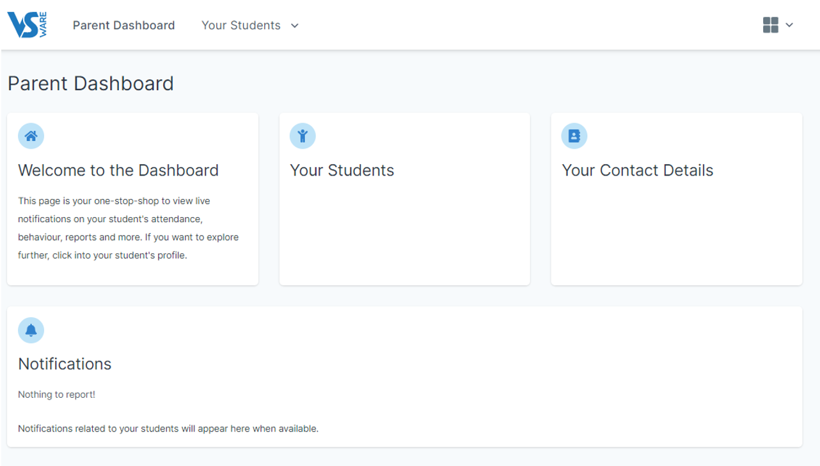

Slide 26
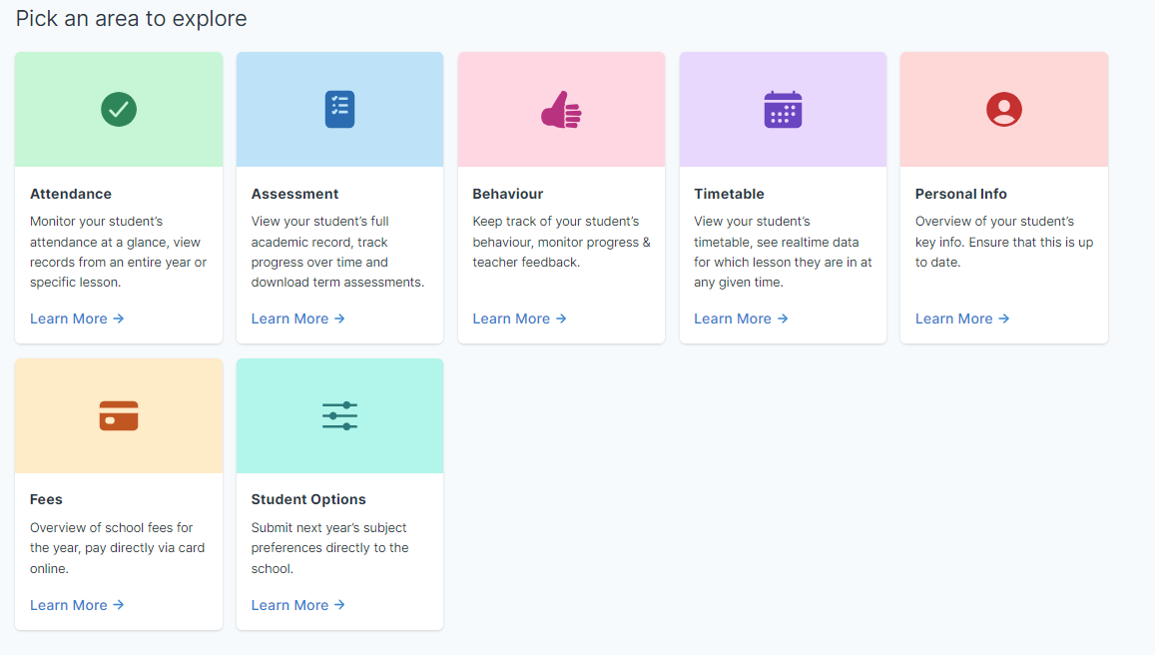

Slide 27
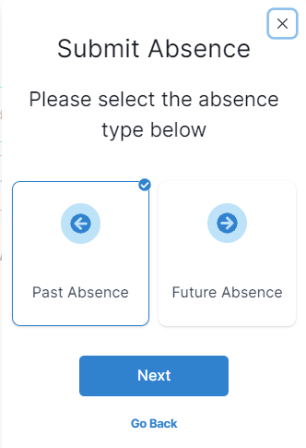

Slide 28
What is Teams?

Slide 29
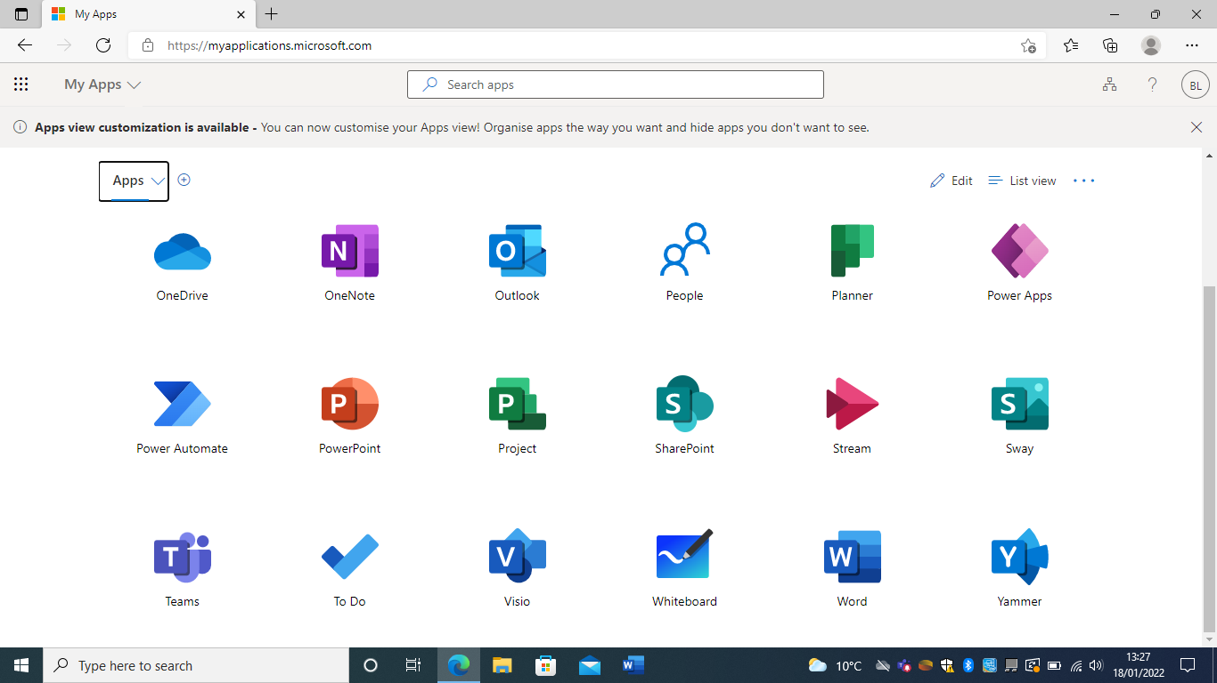
Notes:
Look through the icons and find the one labelled Teams.
This is usually a purple icon

Slide 30
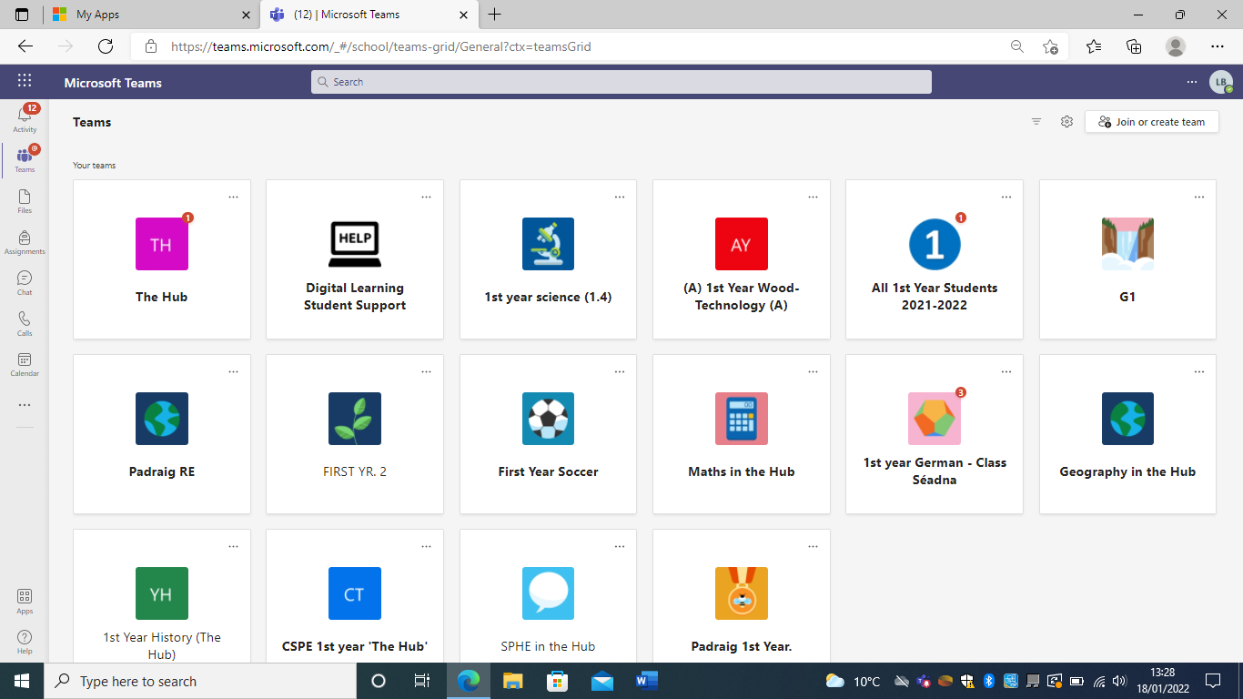
What happens in a Team?
Learning space for students
Teacher has a Team set up for their class/sports team/club etc.
Share resources with students
Submit assignments
Engage in class discussions
Can chat teacher if help is needed
Catch up on classwork if absent

Slide 31
Guidelines and Protocols for working on Teams
Discussion should at all times be respectful, appropriate and related to the specified subject.
Students are themselves responsible for what they upload and comment on Teams.
Only students in St Caimin’s Community School are permitted to access the schools Teams account.
To protect the privacy of all, no other person should be in the Team class other that the students of the class and teacher, this includes family members.
Behaviour on Teams is governed by our Acceptable Usage Policy and our Code of Behaviour

Slide 32
Mobile Phones

Slide 33
When can I use my mobile phone?
Morning time
Break times
End of school day
During class time with the teachers’ permission
NOT in the corridors between classes

Slide 34
Mobile phones …….
Must be switched off and kept in the student’s possession during the school day.
Are not permitted during or between classes
Cannot disrupt teaching and learning
Must be placed on the teachers’ desk before a student leaves class to go to the bathroom
Cannot be brought into the PE hall or changing room area

Slide 36
If you are found to be using a mobile phone outside of the appropriate times ……
The phone and sim card will be confiscated and placed in the Principal’s office
The confiscating teacher will sign and date the record sheet in the office
The phone will be returned to the student at the end of the school day
Failure to hand up the phone and/or sim card to the subject teacher will result in a more severe sanction e.g. phone kept for 48 hours and a lunchtime detention.
More severe sanctions will also apply for repeat offenders.

Slide 37
A student, who wishes to go home for any reason during the school day, must arrange to do so through their timetabled subject teacher and the Secretary/Deputy Principal/Principal/Year Head and not independently by mobile phone.
This ensures that correct procedures for leaving school before the ending of classes for that day are observed.
Responsibility cannot be taken by the school authorities for students who arrange independently to go home without following proper procedure.
Any such arrangement is a breach of the Code of Behaviour.
Parents/Guardians may arrange to contact students through the office (061) 364211. We ask parents/guardians to co-operate and support this policy by not contacting students by mobile phone during the school day.

Slide 38
Behaviour on Social Media
Behaviour on social media: If a message causes upset, this is a form of harassment and can be prosecuted as such. Students who receive upsetting text messages are advised to:
Keep a copy of these message/messages
Block the sender and
Report the message to their parents or teachers or even the Gardaí themselves.
This is something we take very seriously - all students should treat themselves and each other with respect.

Slide 39
Concerns around over use of an electronic device
Excessive use of electronic devices has been linked with
Interference with social activities and family time
Interference with sleep
Damage to mental health
The risk of obesity

Slide 40
Uniform

Slide 41
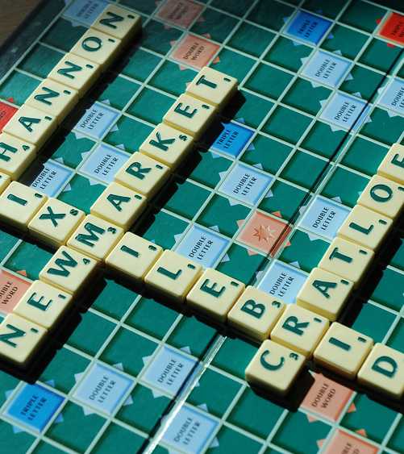
Why do we have a school uniform?
Promotes a community identity – pride in being part of St. Caimin’s Community and increases school spirit
Helps with cohesion and equality – level playing field for all and saves on costs
Reduces peer pressure
Prepares you for the outside world
Makes preparation in the morning much easier

Slide 42
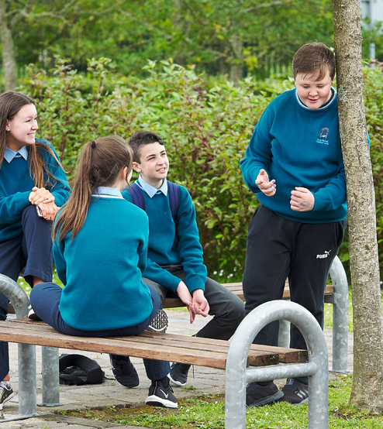
Our School Uniform
School jumper
Trousers – Grey for boys
Trousers – Navy for Girls
School skirt with navy knee length shorts or navy tights
Light blue shirt

Slide 43
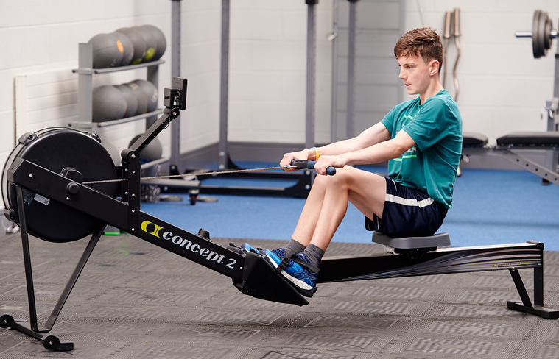
PE Class
Track suit bottoms
Sweatshirt
Polo shirt/T-shirt
Runners

Slide 44
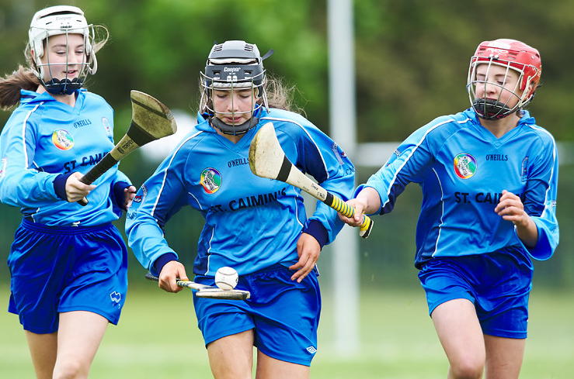
School Sports and Uniform
Always have your school unform with you on the day of matches or trips in the event of cancellation etc.

Slide 45
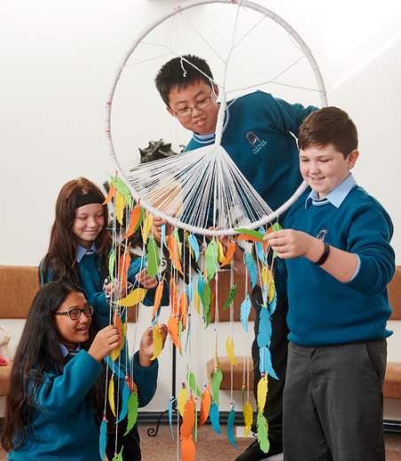
What happens if I am not in full uniform
It is essential that each student have 2 sets of everything
Please inform Year Head if there is a problem
Our code of behaviour will be applied for students who persistently are presenting out of uniform

Slide 46
What happens if I am not in full uniform
Once off- note from Year Head to excuse student.
Offered school stock uniform item.
Repeat offenders- Parent's contacted to bring uniform to school.
Repeat offenders- Detention

Slide 47
Parent Support

Slide 48
Website
Useful links to online supports
Keep up to date on school news, enrolment, options, Calander and parent teacher meetings.
Parents Association
Meeting every 4-6 weeks
Agreed Report published on our website.

Slide 49
Wellbeing Supports
Contact our Student Support Team
Principal/Deputy Principal
Year Head
Guidance Counsellor
Chaplain
SEN Coordinator
Supports include
Breakfast Club 8.15am -8.45am in room 143
Homework Club 8.15am -8.45am in room 157
CAMHS
Tulsa
Occasionally External Counsellors & Art Therapy
Talks from External agencies
Wellbeing Week, Celebrate Us Week & Stand Up Awareness Week.

Slide 51
6th Year Examinations
Assessment type | Dates
October Assessments | 9th -13th October
Mock Exams | 29th January -9th February

Slide 53
Contact Information
 | Responsibility of | Contact Information
1st Year | Ms O’Loughlin | tara.oloughlin@stcaimins.ie
2nd Years | Ms Dalton | mary.dalton@stcaimins.ie
3rd Years | Ms Ryan Quinn | michelle.ryan@stcaimins.ie
LC1/LCA1/TY | Mr Keane | gerard.keane@stcaimins.ie
LC2/LCA2 | Ms McSweeney | siobhan.mcsweeney@stcaimins.ie
SEN Queries | Ms Sheehan | maria.sheehan@stcaimins.ie
Chaplain | Ms Guinnane | cora.guinnane@stcaimins.ie
Guidance | Ms Christie | fiona.christie@stcaimins.ie

